Slide 1
umx
Tim Bates

Slide 2
User library for OpenMx
Install the package
install.packages("umx”)
A tutorial guide
http://tbates.github.io
The github source (not needed)
http://www.github.com/tbates/umx

Slide 3
Easier Path-based modeling
umxRAM()
umxPath()
var = , v1m0 = , fixedAt = 1, with
umxSummary()
umxCompare()
report
plot()
In browser plots! (also editable in apps omnigraffle)
umxModify()
Re-run, drop and add paths, set by lable

Slide 4
1-line Twin Modeling
umxACE()
Raw or cov, mixed ordinal, ADE just set DZr = .25)
umxGxE()
plots
umxCP()
Multiple common factors
umxIP()
Set by label
umxACEcov()
Covariates in the variance model (great for missing data)

Slide 5
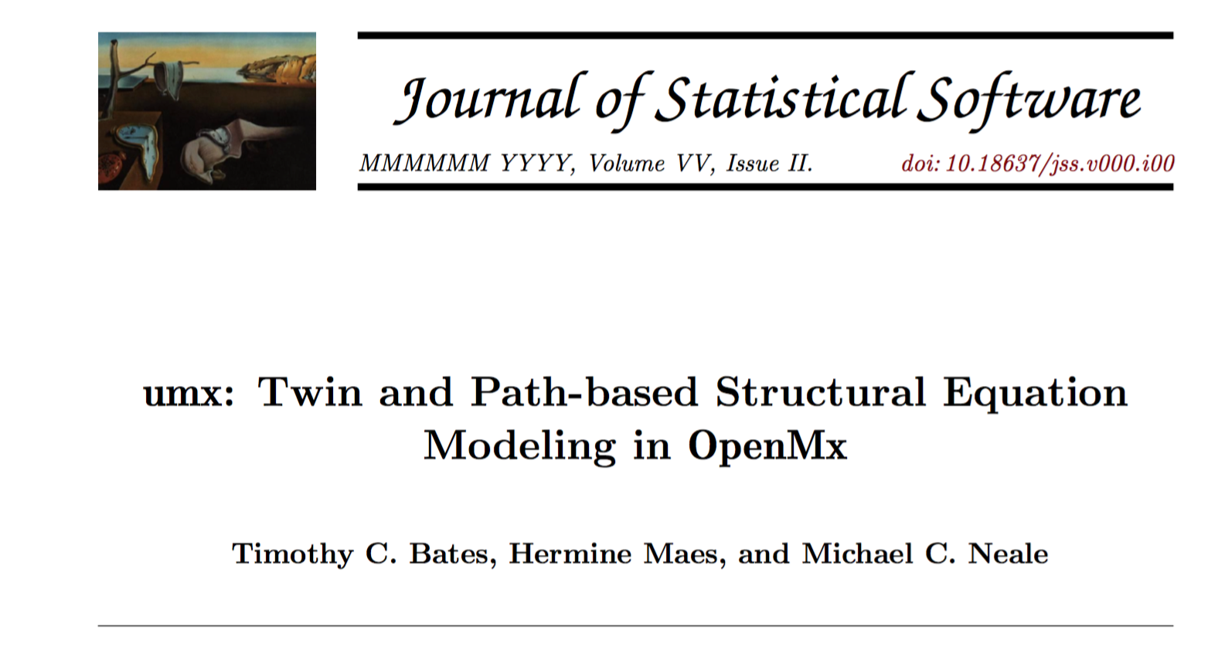
Paper soon under review

Slide 6
Let’s see how it works

Slide 7
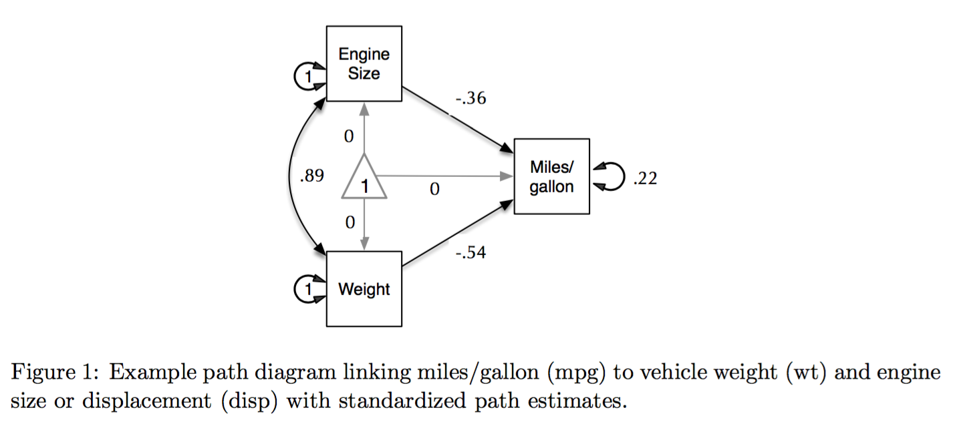
What you would like from OpenMx

Slide 8
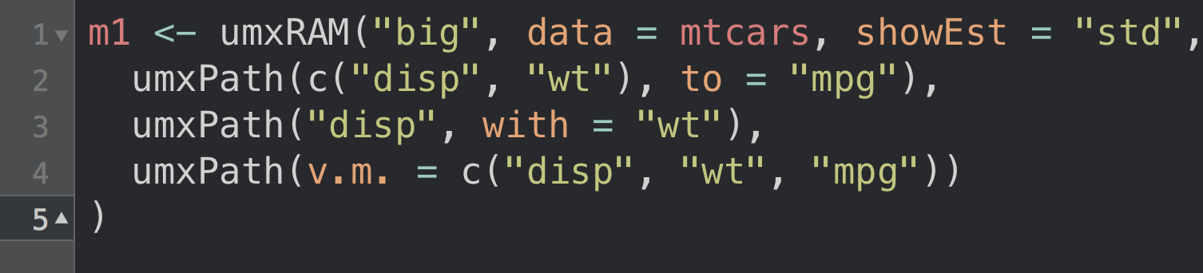
Model in umxRAM

Slide 9
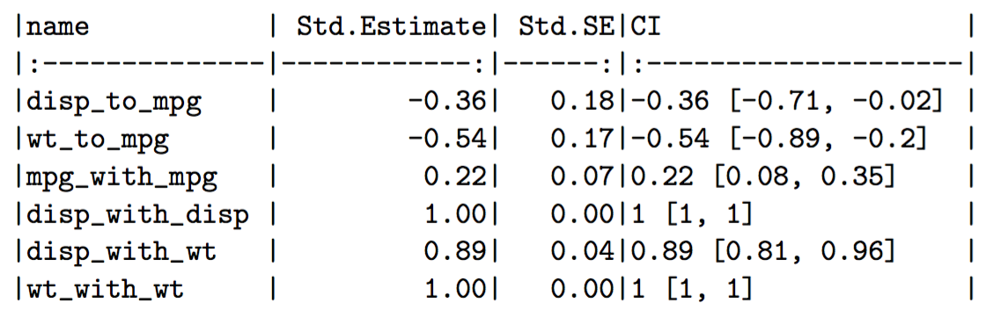
Auto-run, and summary
χ2(87) = 0,p < 0.001;CFI = 1;TLI = 1;RMSEA = 0

Slide 10
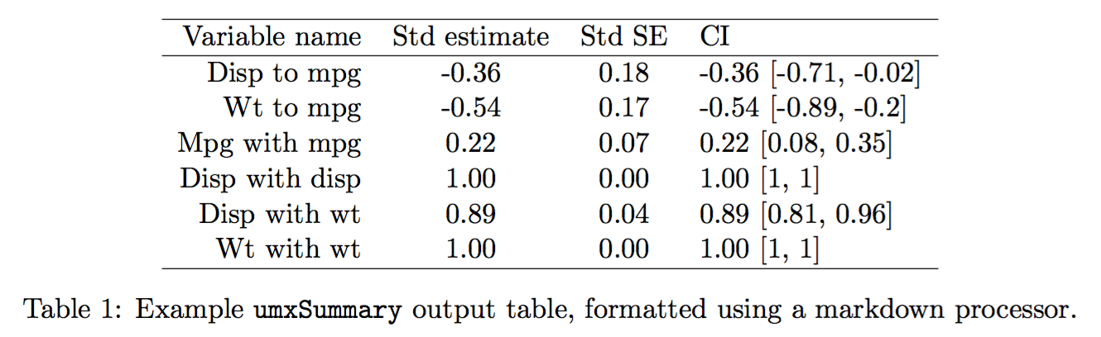
LaTeX output: try umx_set_table_format("")

Slide 11
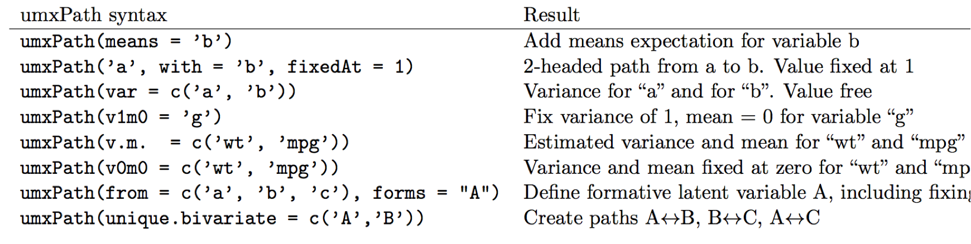
Several SEM shortcuts for making paths

Slide 12
plot() works for most models!
plot(m1, means = F, std = T, showFixed = T)

Slide 13
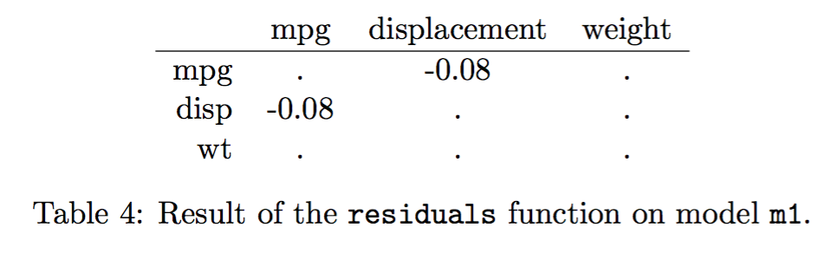
Many “normal” R functions like residuals() work for RAM models

Slide 14
Modify models
m2 = umxModify(m1, update = "disp_to_mpg", name = "no_disp", comp = TRUE)
umxModify(m1, update = "^disp_to.*", regex = TRUE)
umxModify(m1, regex = "^disp_to.*")

Slide 15
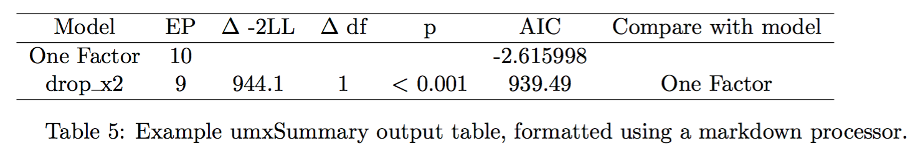
umxCompare() models

Slide 16
Try: umxCompare(m1, m2, report = "html")

Slide 17
Equate parameters
m2 = umxEquate(m1,
master = "G_to_x1",
slave = "G_to_x2",
name = "Eq”
)
umxCompare(m1, m2)

Slide 18
Drop paths
paths = c("c_cp_r1c1", "cs_r1c1", "cs_r2c2")
m2 = umxModify(m1, update = paths)
pat = "(^cs_)|(^c_cp_)”
m2 = umxModify(m1, update = pat, regex = TRUE,
name = "dropC")
umxSummary(m2, comparison = m1)

Slide 19
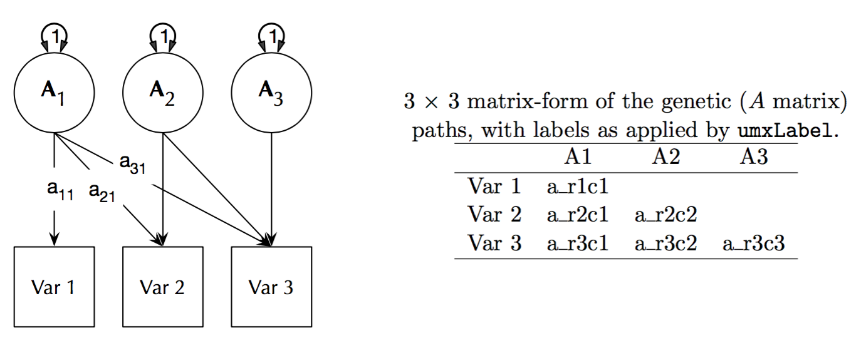
umxACE

Slide 20
umxACE
# still need data…
require(umx);
data("twinData")
selDVs = c("wt1", "wt2")
df = twinData[twinData$cohort == "younger"]
dz = df[df$zyg == "DZFF", selDVs]
mz = df[df$zyg == "MZFF", selDVs]

Slide 21
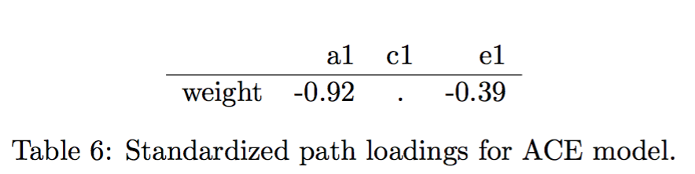
umxACE: But not so many lines of code
m1= umxACE(selDVs = selDVs, dzData= dz, mzData= mz )
umxSummary(m1)
−2 × log(Likelihood) = 12186.28 (df = 4)

Slide 22
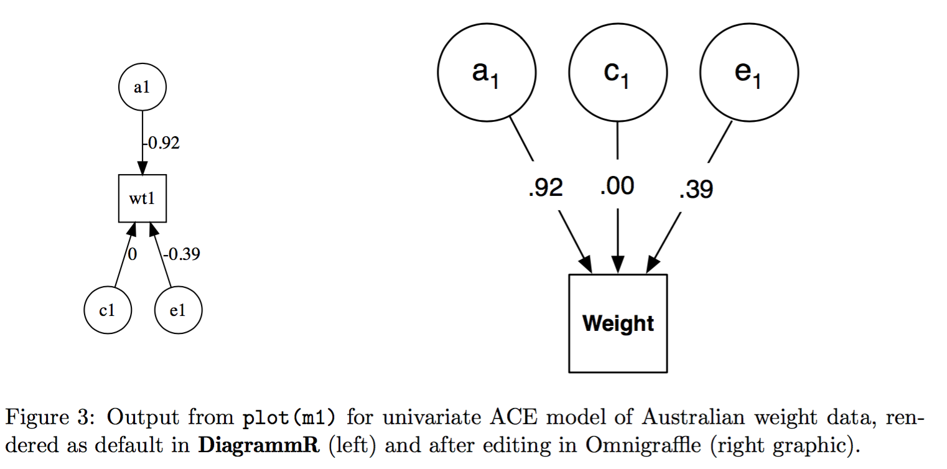
plot() works for twin models!

Slide 23
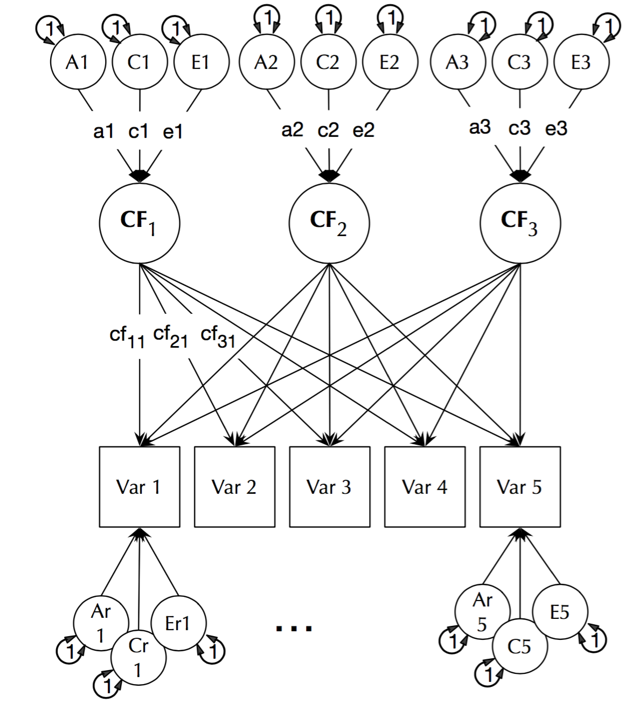
umxCP: multiple common factors

Slide 24
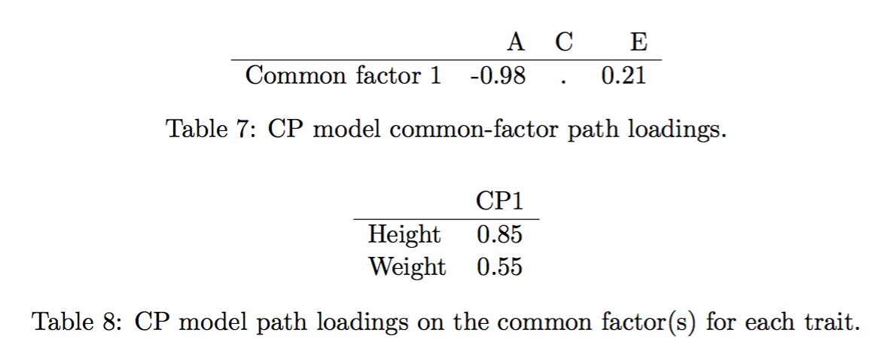
umxCP
m1 = umxCP(selDVs = selDVs,
dzData = dzData,
mzData = mzData,
suffix = "”
)

Slide 25
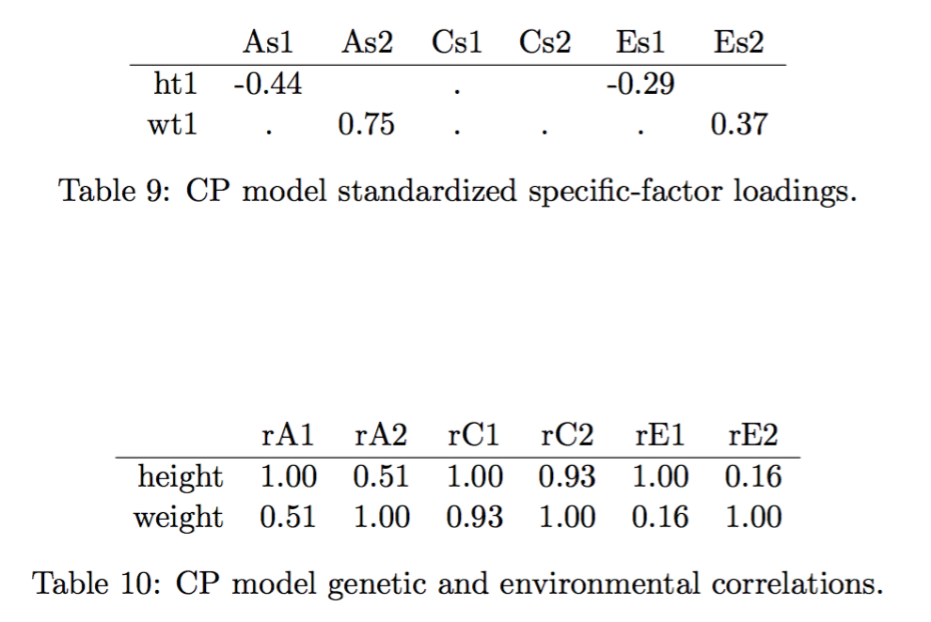
umxCP

Slide 26
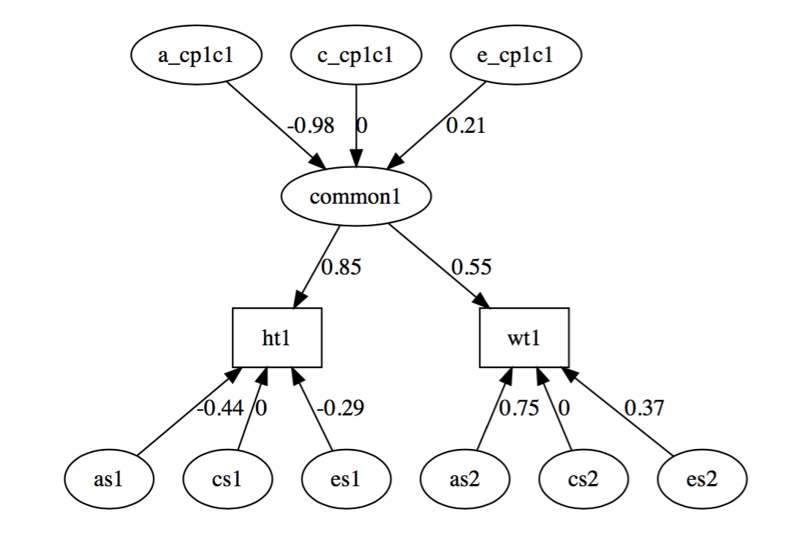
plot()

Slide 27
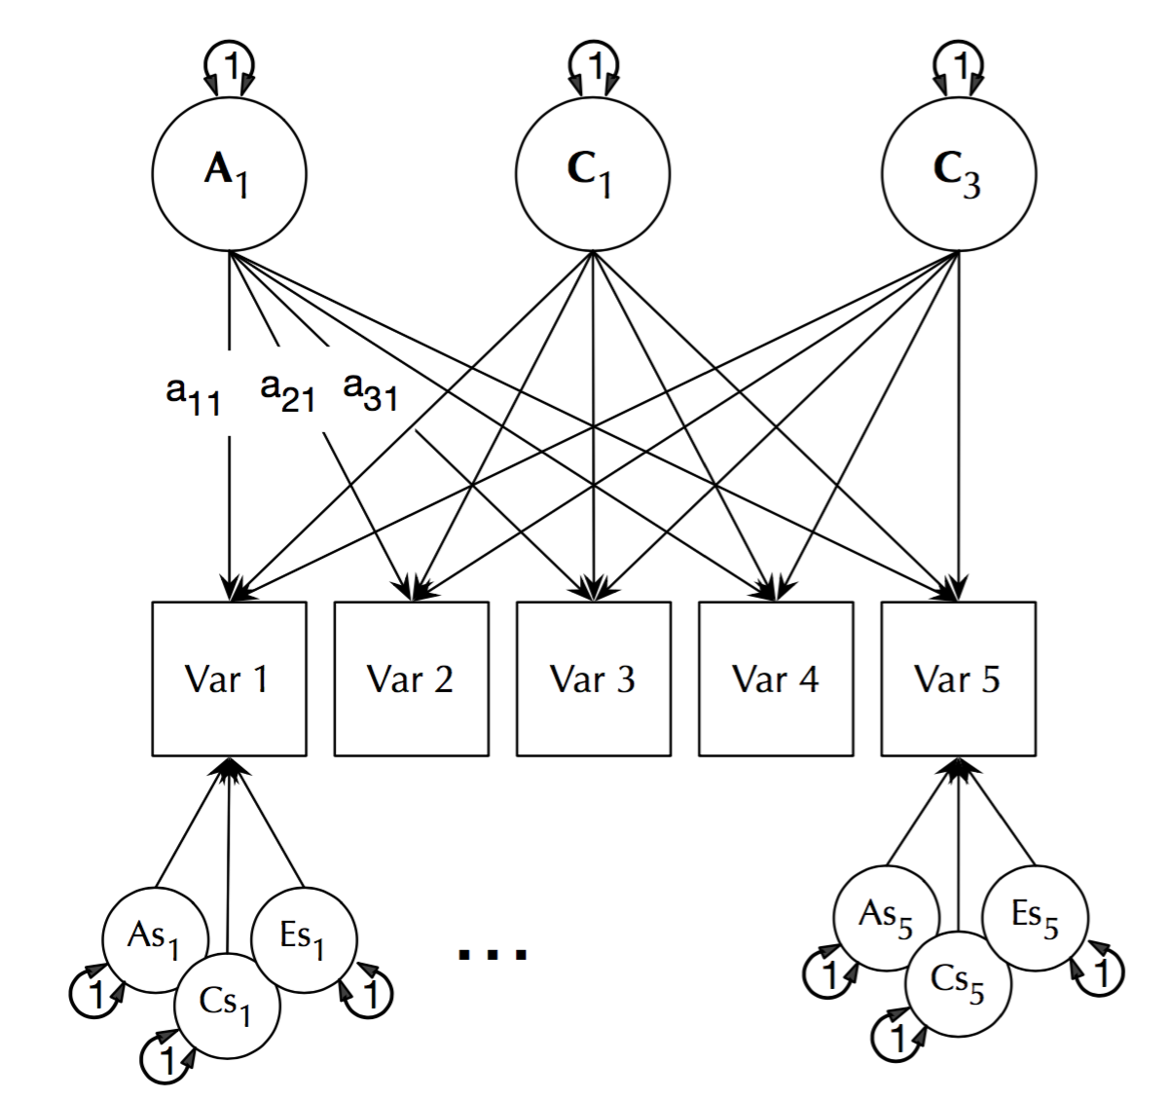
umxIP

Slide 28
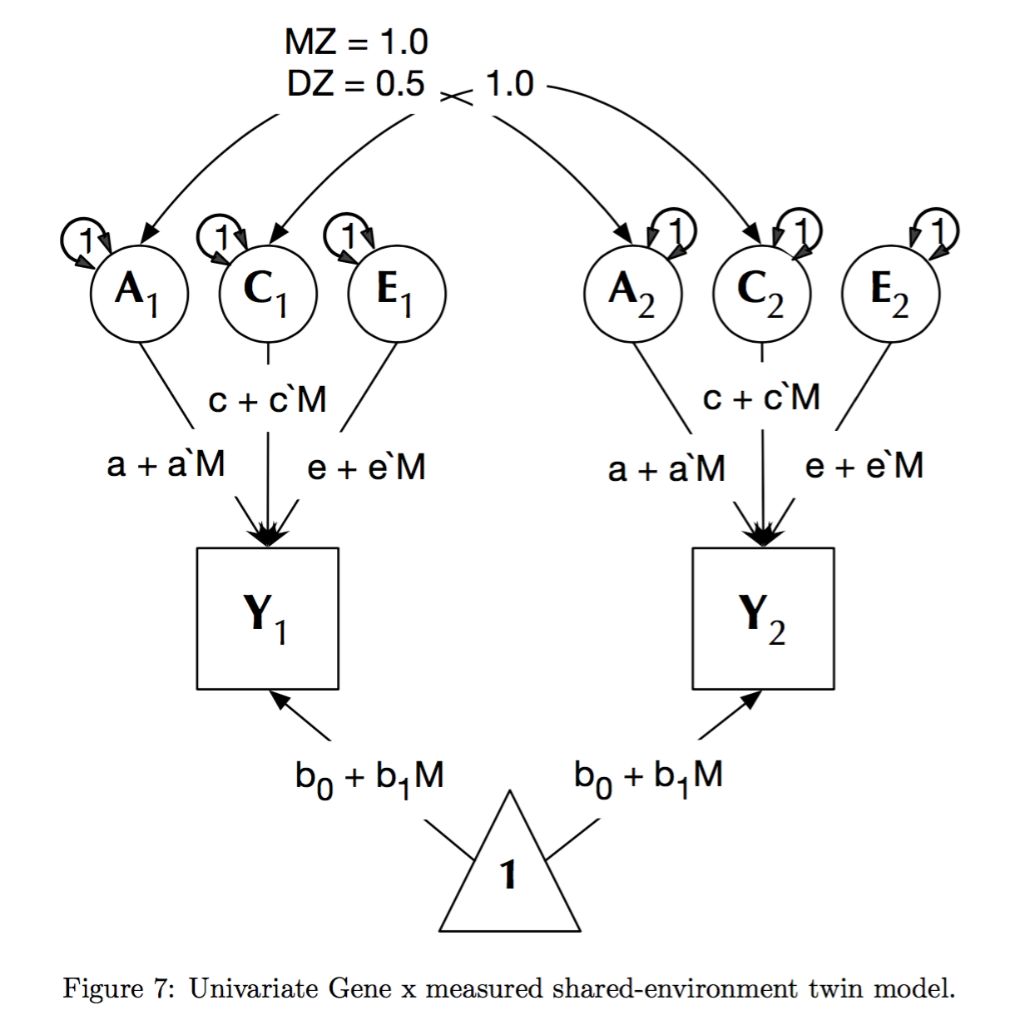
umxGxE
m1 = umxGxE(selDVs = selDVs, selDefs = selDefs,
dzData = dzData,
mzData = mzData
)

Slide 29
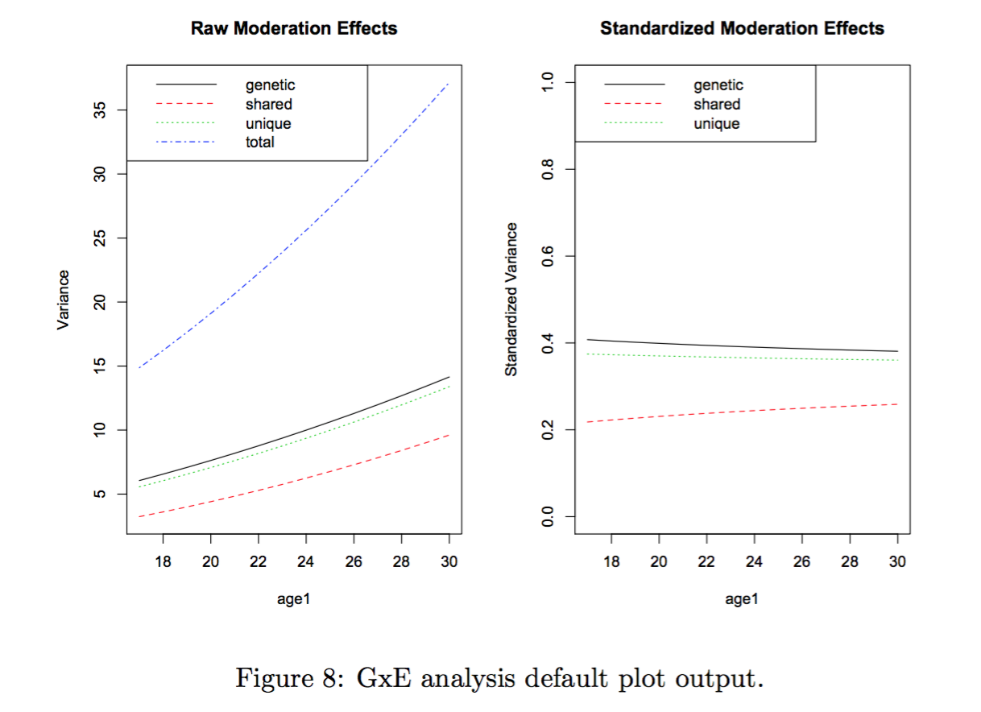
umxGxE plot output

Slide 30
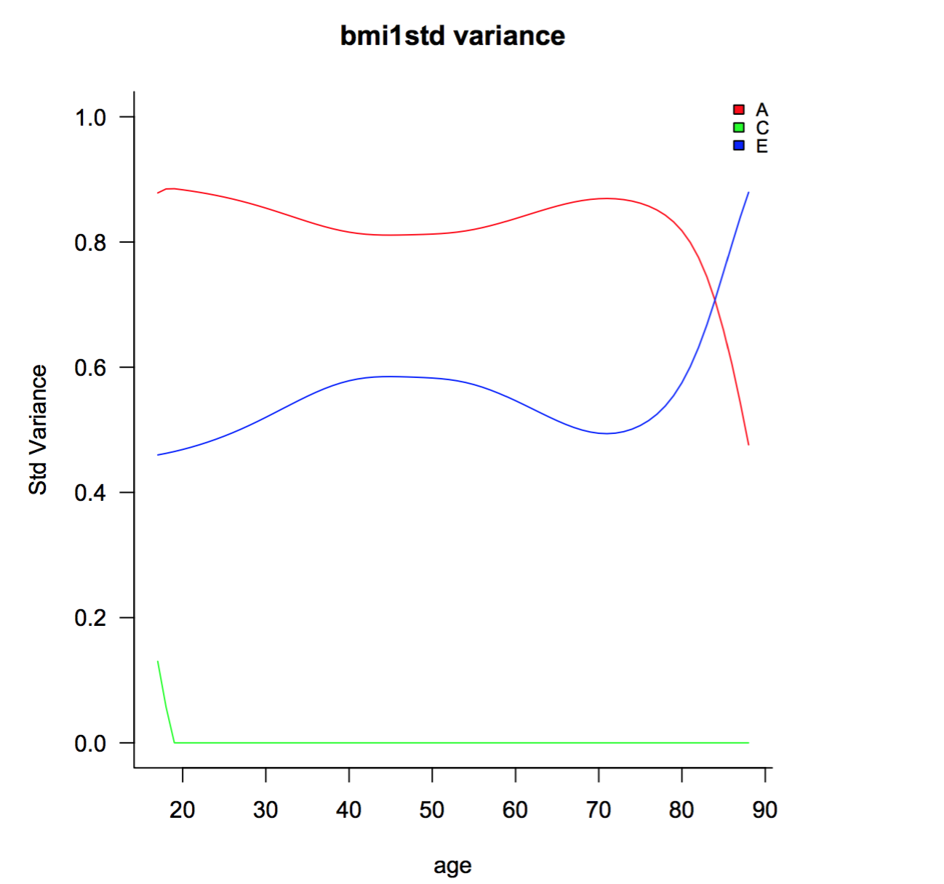
Windowed GxE

Slide 31
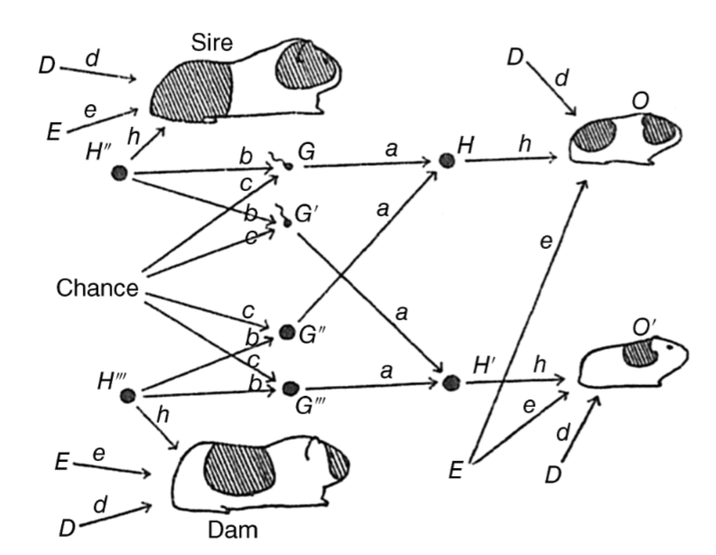
umx is the new guinea pig!

